Slide 1

END-TO-END REAL-TIME WEATHER DATA PIPELINE WITH MEDALLION ARCHITECTURE
SUBJECT : BIG DATA & DISTRIBUTED PROCESS (MCSCIN5A1825)
PROFESSOR: PROF. ZHANG YIRU, PROF. LI YUE
SUBMITTED BY:
VISSHNU PRETHI MANJERE KUMAR & YAAMINI SREE DILLI SHANKAR
-

Slide 2
PROJECT OVERVIEW
This project implements an end‑to‑end big data pipeline that ingests real‑time weather data for berlin from the open-meteo “current weather data” api and processes it using a medallion (raw(bronze)/silver/gold) architecture on a distributed hadoop/spark cluster. The pipeline lands raw data in hdfs, cleans and aggregates it with spark, stores time‑series metrics in influxdb, and visualizes them on a grafana dashboard for near real‑time monitoring.
The main objectives are:
Ingest live api data into kafka and persist it reliably in a data lake (hdfs).
Build raw(bronze)/silver/gold layers for reproducible analytics and daily weather summaries.
Expose berlin weather kpis through influxdb and grafana for time‑series analysis.

Slide 3

PROJECT OBJECTIVES & SCOPE
Business Problem
Fragmented Data Sources: Weather data scattered across multiple vendor APIs, manual reports, and internal sensors with inconsistent formats and availability.
Delayed Insights: Lack of unified streaming pipeline causes 15-60 minute delays in actionable weather intelligence reaching operations teams.
No Historical Analytics: Impossible to correlate past weather events with service costs, response times, or infrastructure damage patterns.
Siloed Visualization: Operations teams use separate Excel sheets, static reports, and vendor portals – no single source of truth dashboard.
Scalability Issues: Manual processes cannot handle increased data volume from additional sensors or multi-city expansion.

Slide 4
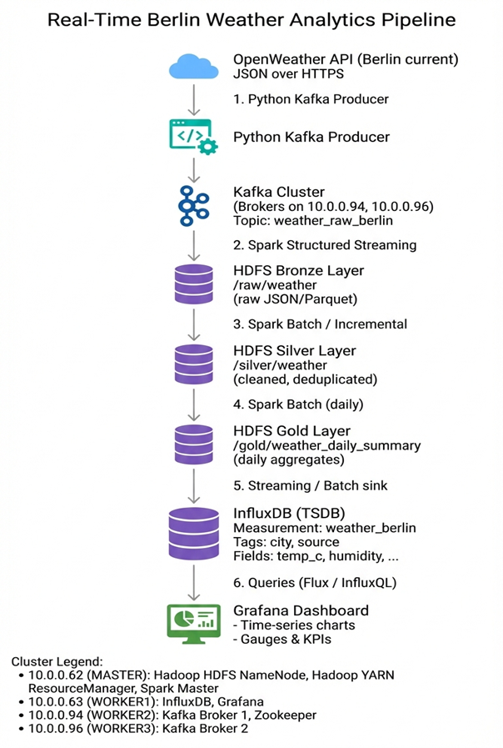
ARCHITECTURE DIAGRAM

Slide 5
TECHNICAL REQUIREMENTS
Live api ingestion → kafka → hdfs data lake → spark → influxdb tsdb → grafana
Multi-node distributed deployment (hdfs, spark, kafka, influxdb, grafana)
Exactly-once processing with fault tolerance
Network Connectivity
Grafana: 3000
InfluxDB:8086
Kafka: Brokers 9092

Slide 6
DATA SOURCE
The pipeline uses the open-meteo current weather data api to fetch live measurements for berlin. The api is called via https with parameters specifying location and units
https://api.open-meteo.com/v1/forecast?latitude=52.52&longitude=13.41&current=temperature_2m,wind_speed_10m&hourly=temperature_2m,relative_humidity_2m,wind_speed_10m
The json payload contains:
Location: coord.lat, coord.lon, name (city name).
Core weather metrics: main.temp, main.humidity, main.pressure, wind.speed, clouds.all, weather[0].description, and timestamp dt in unix utc.
{
...
"cURRENT": {
"TIME": "2022-01-01T15:00",
"TEMPERATURE_2M": 2.4,
"WIND_SPEED_10M": 11.9,
},
"HOURLY": {
"TIME": ["2022-07-01T00:00","2022-07-01T01:00", ...],
"WIND_SPEED_10M": [3.16,3.02,3.3,3.14,3.2,2.95, ...],
"TEMPERATURE_2M": [13.7,13.3,12.8,12.3,11.8, ...],
"RELATIVE_HUMIDITY_2M": [82,83,86,85,88,88,84,76, ...],
}
}

Slide 7
DISTRIBUTED CLUSTER CONFIGURATION
The solution runs on a small distributed cluster with a clear separation of control, storage, and messaging roles, in line with the course’s “cluster map” requirement.
SERVICES RUNNING | S.NO | IP | NODE MODULES
Hadoop HDFS NameNode, Hadoop YARN ResourceManager, Spark Master | 1 | 10.0.0.62 | MASTER
InfluxDB, Grafana | 2 | 10.0.0.56 | WORKER 1
Kafka Broker 1, Zookeeper | 3 | 10.0.0.94 | WORKER 2
Kafka Broker 2 | 4 | 10.0.0.96 | WORKER 3
This mapping aligns with the assignment’s “component / role / host / port” summary and shows where influxDB and grafana are deployed relative to hdfs, spark, and kafka.

Slide 8
DISTRIBUTED CLUSTER CONFIGURATION
The solution runs on a small distributed cluster with a clear separation of control, storage, and messaging roles, in line with the course’s “cluster map” requirement.
SERVICES RUNNING | S.NO | IP | NODE MODULES
Hadoop HDFS NameNode, Hadoop YARN ResourceManager, Spark Master | 1 | 10.0.0.62 | MASTER
InfluxDB, Grafana | 2 | 10.0.0.63 | WORKER 1
Kafka Broker 1, Zookeeper | 3 | 10.0.0.94 | WORKER 2
Kafka Broker 2 | 4 | 10.0.0.96 | WORKER 3
This mapping aligns with the assignment’s “component / role / host / port” summary and shows where influxDB and grafana are deployed relative to hdfs, spark, and kafka.

Slide 9
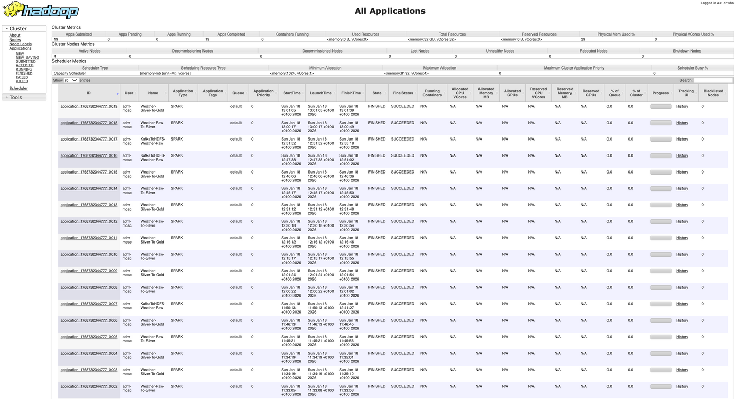
HDFS CLUSTER
Architecture
Master node manages metadata and coordinates cluster operations
Worker node stores actual data blocks with automatic replication
2x replication ensures fault tolerance across nodes
Installation Process
Download and extract Hadoop distribution to standard location
Configure environment variables for system-wide access
Format the NameNode to initialize the file system
Configuration Steps
Point all nodes to master NameNode via core configuration
Set replication factor to match available worker nodes
Define storage directories for metadata and data blocks
Data Lake Organization
Bronze layer stores raw streaming events from Kafka
Silver layer contains cleaned, validated, typed records
Gold layer holds business-ready daily aggregates and metrics
Monitoring & Verification
Web interface shows live cluster health and storage usage
YARN interface displays running Spark jobs and resource allocation
Command-line tools verify services and data integrity
Spark Integration Role
Spark Structured Streaming reads directly from Kafka topics
Processes data through transformation pipeline
Writes structured Parquet files to appropriate HDFS layers

Slide 10
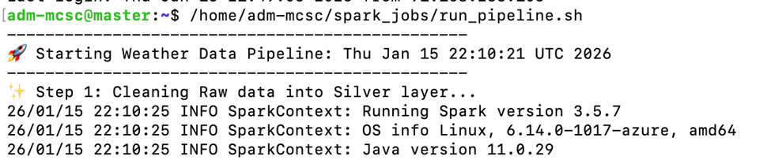
MEDALLION ARCHITECTURE ON HDFS
The data lake is organized following the raw(bronze)/silver/gold medallion architecture recommended for scalable analytics. All layers are stored in hdfs and processed by spark.
Bronze layer: raw data (/raw/weather)
Spark structured streaming reads from the weather_raw kafka topic with a suitable schema that matches the open-meteo json.
The job writes data to hdfs under /raw/weather/ in json or parquet, partitioned by event date, such as /raw/weather/event_date=2026-01-14/.
Raw data is immutable and preserves the original api payload, which enables replay and backfills if downstream logic changes.

Slide 11
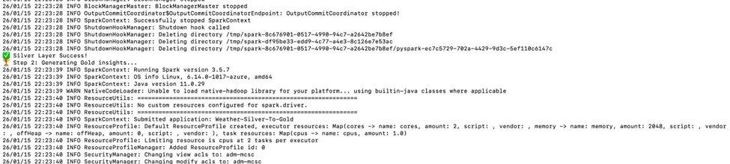
Silver layer : cleaned data
A spark batch or incremental job reads the bronze data, parses the json, and enforces a consistent schema.
Transformations include:
Casting types (e.g., temp to double, event_time to timestamp).
​Computing derived fields such as temp_c or normalizing units (e.g., always metric).
​Removing duplicates based on a composite key (city, event_time) or kafka offset metadata.
​Extracting partition columns such as event_date = to_date(event_time).
​Output is stored as parquet and is considered the single source of truth for analytics.

Slide 12
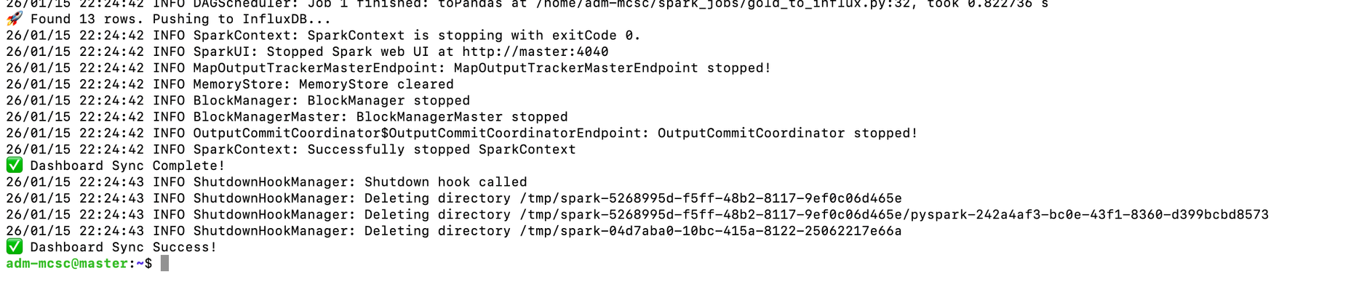
Gold Layer :aggregated daily summaries
A spark batch job reads silver data and computes daily aggregates per city, writing the results
​Example metrics:
Min_temp_c, max_temp_c, avg_temp_c.
Min_humidity, max_humidity, avg_humidity.
Avg_wind_speed, obs_count.
These tables provide business‑ready insights for visualization and reporting, simplifying queries in dashboards.

Slide 13
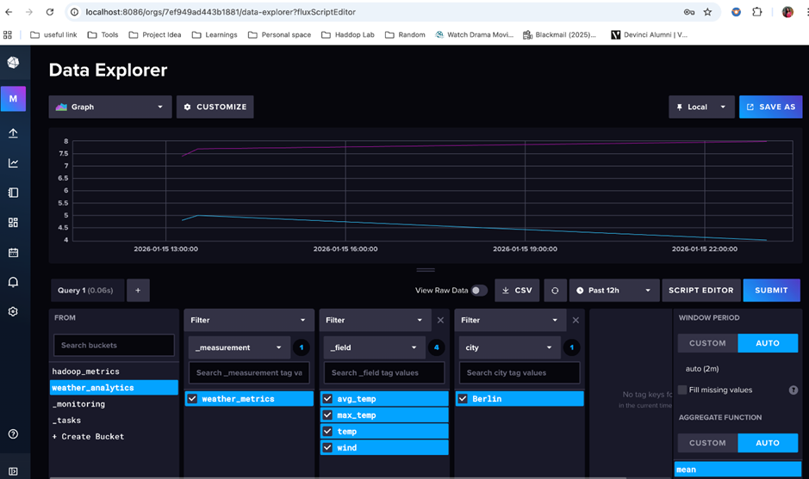
TIME‑SERIES STORAGE DASHBOARD
Influxdb design:
Influxdb is used as the time‑series database (tsdb) to store high‑resolution weather metrics for berlin. The data model is:
​Measurement: weather_raw.
​Tags (indexed dimensions):
City = "berlin"
Source = "open-meteo"
Fields = Temp_c, humidity, pressure, wind_speed, clouds, possibly rain_1h.
Timestamp: event time from open-meteo (dt converted to a timestamp).
​A streaming sink (either a spark structured streaming sink or a small python/scala consumer) reads from kafka or the silver layer and writes line protocol to influxdb, for example:
Weather_berlin, city = berlin, source=open-meteo, temp_c = 8.4, humidity=75, pressure=1016, wind_speed=3.21736888400000000000
​A retention policy (e.g., 30 days) can be configured on the bucket to prevent unbounded growth while keeping enough history for trend analysis.

Slide 14
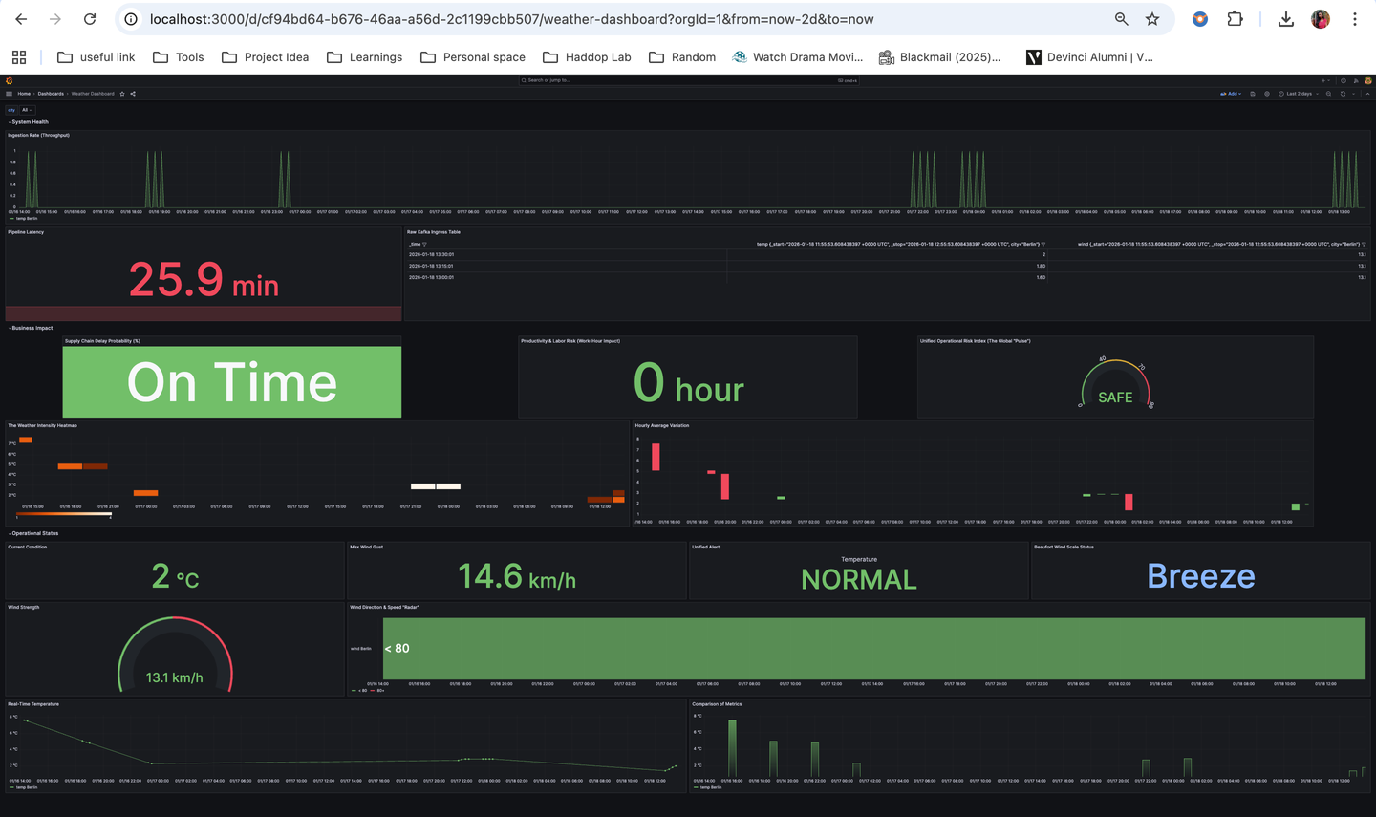
GRAFANA DASHBOARD
Grafana is configured to read from the influxdb bucket containing weather_analytics. The dashboard includes:
​
Time‑series panels:
Temperature vs time (last 24 hours, last 7 days), querying the temp_c field for weather_analytics.
​Humidity and pressure trends, possibly overlayed or separated, using humidity and pressure fields.
Operational Stats:
Real-time monitoring for operations teams (5-minute refresh)
Business Insights:
Correlates weather → operations costs → savings from predictive maintenance
System Health:
Mark Spark job restarts, Kafka rebalances, API outages

Slide 15
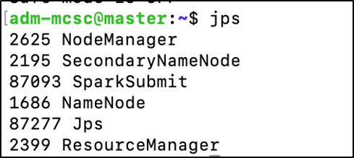
ORCHESTRATION
A bash script run_pipeline.sh orchestrates the different components of the pipeline.
Typical steps include:
1. Start Master and Other Worker node
2. Start zookeeper
From your kafka install dir ( /opt/kafka/kafka_2.13-3.6.0) and start zookeeper. ZooKeeper listens on port 2181 by default
3.Start Kafka brokers
Once ZooKeeper is up, start each broker (each node has its own server.properties).​
4. Create kafka topic(s) such as weather_raw using kafka-topics.sh.
5.Submit the spark structured streaming job that reads kafka and writes bronze data to /raw/weather with checkpointing enabled for exactly‑once semantics.
​Trigger silver and gold spark batch jobs, either immediately, using spark-submit pointing to the master at 10.0.0.62.
6.Ensure influxdb and grafana services are started on the worker1 node and reachable from the cluster.
7.Start the python kafka producer that polls the open-meteo api and streams new weather events into kafka.
.

Slide 16
KEY DESIGN DECISIONS
Fault tolerance
Kafka: topic replication factor 2 across 2 brokers
Spark: checkpointing enabled, exactly-once semantics
Hdfs: 3x replication across datanodes
Scalability
Kafka partitions scale with producer throughput
Spark dynamic allocation based on yarn resources
Influxdb continuous queries for downsampling

Slide 17
CONCLUSION
This project successfully delivers an end-to-end, production-style data pipeline for real-time berlin weather analytics, demonstrating mastery of ingestion, storage, processing, and visualization components in a distributed environment. The system reliably captures live data from a public weather api, streams it through kafka, and persists it in hdfs using a medallion (bronze/silver/gold) architecture that separates raw, cleaned, and business-ready layers for robust analytics and future backfills.
By integrating spark structured streaming and batch jobs, the pipeline performs schema enforcement, deduplication, and daily aggregations, turning noisy api events into high-quality features and kpis suitable for decision-making. The use of influxdb as a time-series database, combined with grafana dashboards, enables intuitive real-time and historical monitoring of key metrics such as temperature, humidity, pressure, and wind speed, highlighting the practical value of the architecture for operational observability.
Finally, deploying the solution on a multi-node cluster with clearly defined master and worker roles (for hdfs, yarn, spark, kafka, influxdb, and grafana) shows that the design is not only conceptually sound but also mindful of distributed systems concerns like scalability, fault tolerance, and service separation. Overall, the project meets the stated academic requirements while providing a realistic blueprint for real-world streaming analytics on weather data.

Slide 18
THANK YOU

